Slide 1
15CSE102
Computer Programming
A + B = C

Slide 2
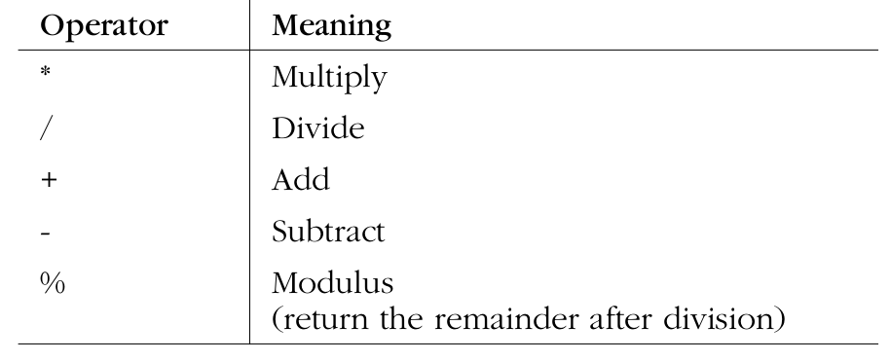
Arithmetic Operators
Credits: Practical C Programming

Slide 3
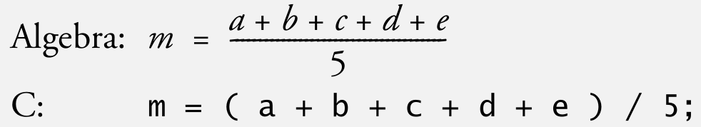
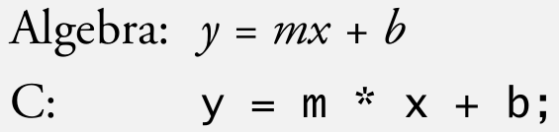
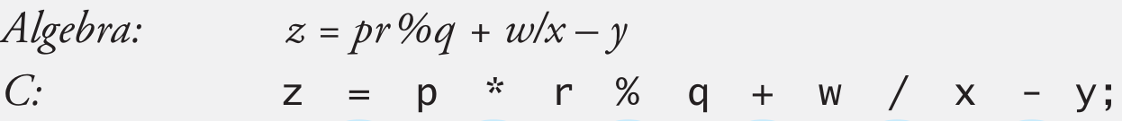
Algebraic vs C Expressions
Credits: How to Program C

Slide 4
Evaluating Expressions
Are these two expressions the same?
m = a + b + c + d + e / 5;
m = (a + b + c + d + e) / 5;

Slide 5
Evaluating Expressions
Are these two expressions the same?
m = a + b + c + d + e / 5;
m = (a + b + c + d + e) / 5;
Depends on the order of evaluation!!

Slide 6
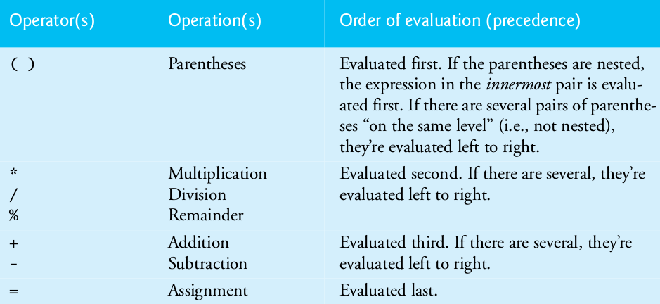
Evaluating Expressions
Credits: How to Program C

Slide 7
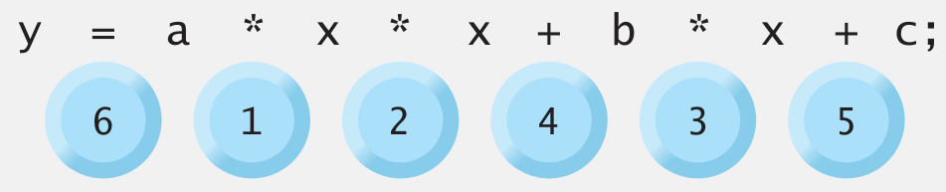
Evaluating Expressions
Credits: How to Program C

Slide 8
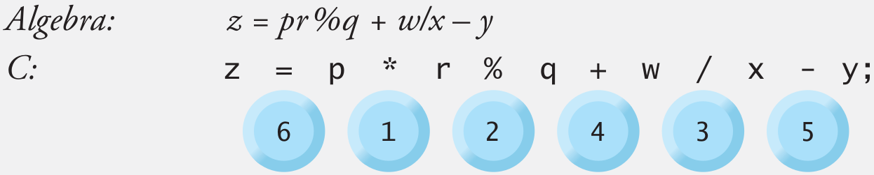
Evaluating Expressions
Credits: How to Program C

Slide 9
Evaluate Expression
Give the value of y
y = 2 * 5 * 5 + 3 * 5 + 7;
Credits: How to Program C

Slide 10
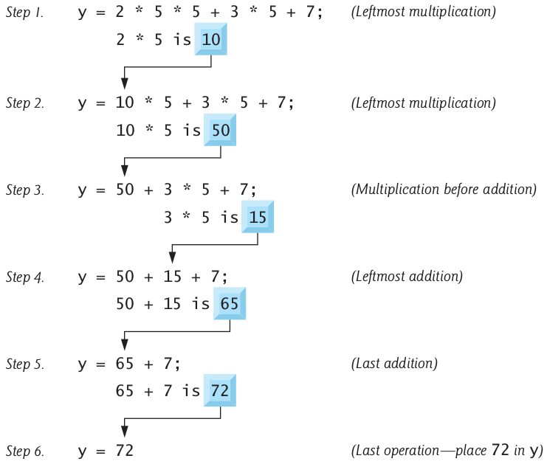
Evaluate Expression
Credits: How to Program C

Slide 11
Evaluate Expression
If you think order of evaluation is
hard to remember
y = 2 * 5 * 5 + 3 * 5 + 7;

Slide 12
Evaluate Expression
If you think order of evaluation is
hard to remember
y = 2 * 5 * 5 + 3 * 5 + 7;
parantheses comes very handy!!!!
y =(2 * 5 * 5) + (3 * 5) + 7;

Slide 13
Be the Compiler
#include <stdio.h>
int main()
{
float c;
c = 5/9;
printf(“c = %f”, c);
return 0;
}
What do you think
is the output of
this code?
Credits: www.tech-recipes.com

Slide 14
Be the Compiler
#include <stdio.h>
int main()
{
float c;
c = 5/9;
printf(“c = %f”, c);
return 0;
}
The following will
be the output
c = 0.000000
Credits: www.tech-recipes.com

Slide 15
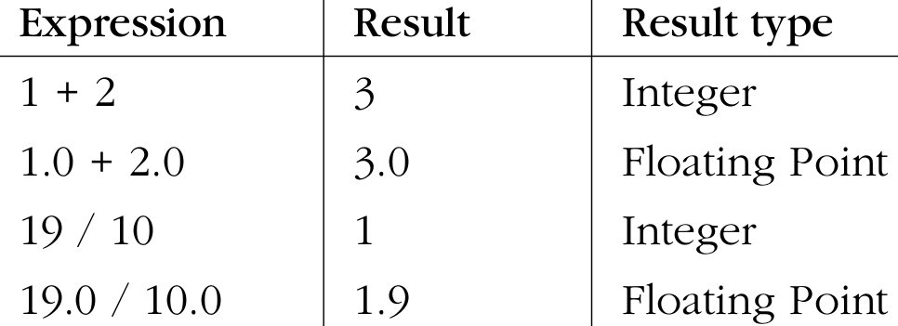
Float vs Integer
Credits: Practical C Programming

Slide 16
Float vs Integer Divide
#include <stdio.h>
int main()
{
float c;
c = 5.0/9;
printf(“c = %f”, c);
return 0;
}
The following will
be the output
c = 0.555556
Credits: www.tech-recipes.com

Slide 17
Remember
1. If an arithmetic operator has integer
operands then integer operation is
Performed (resulting in integer type!)
2. If an arithmetic operator has one
floating point operator and one integer
operator, the integer will be converted
to float before the operation is done
Credits: www.tech-recipes.com

Slide 18
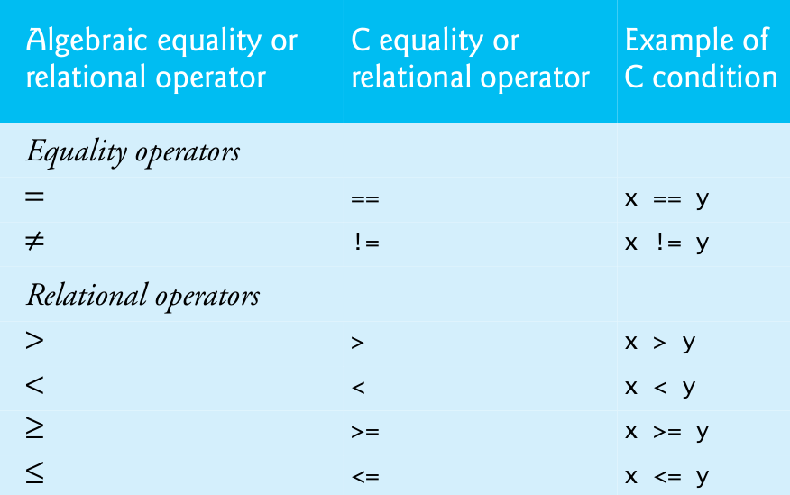
Relational Operators
Credits: How to Program C

Slide 19
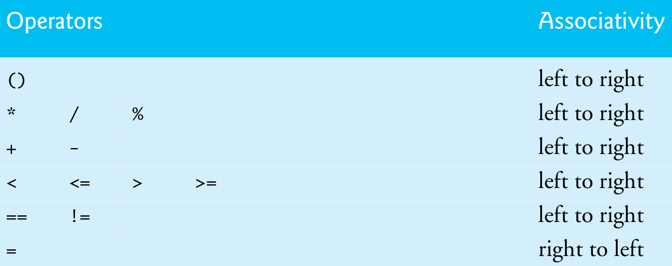
Precedence & Associativity
Credits: How to Program C

Slide 20
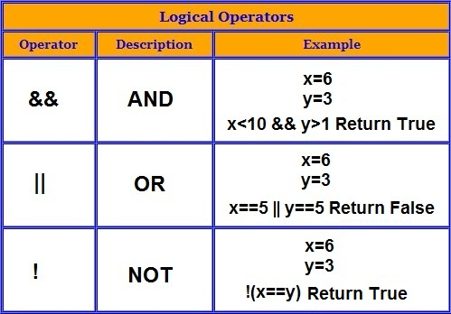
Logical Operators
Credits: studytipsandtricks.blogspot.in

Slide 21
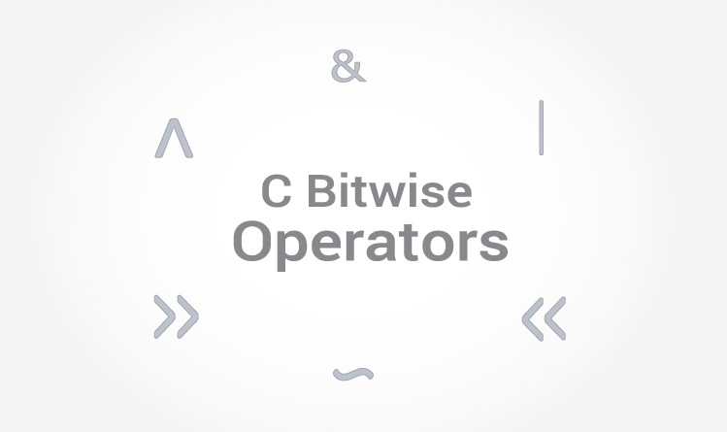
Credits: www.programiz.com

Slide 22
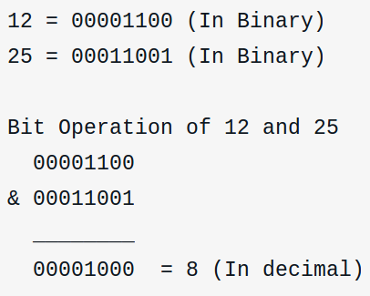
Bitwise AND &
Credits: www.programiz.com

Slide 23
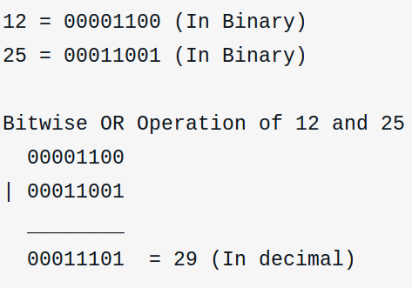
Bitwise OR |
Credits: www.programiz.com

Slide 24
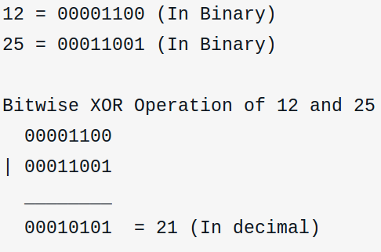
Bitwise XOR ^
Credits: www.programiz.com

Slide 25
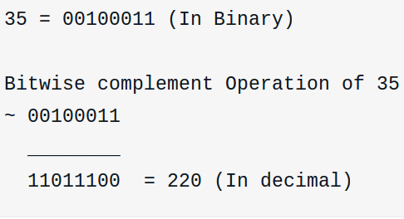
Bitwise Complement ~
Credits: www.programiz.com

Slide 26
Bitwise Complement ~
But the bitwise complement of
35 is -36 how?

Slide 27
Bitwise Complement ~
Negative numbers are stored as two’s
complement of positive counterpart.
220 is two’s complement of -36!!

Slide 28
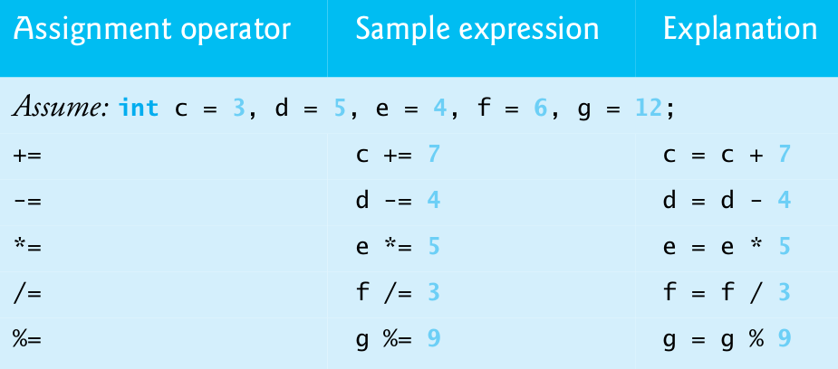
Assignment Operators
Credits: How to Program C

Slide 29
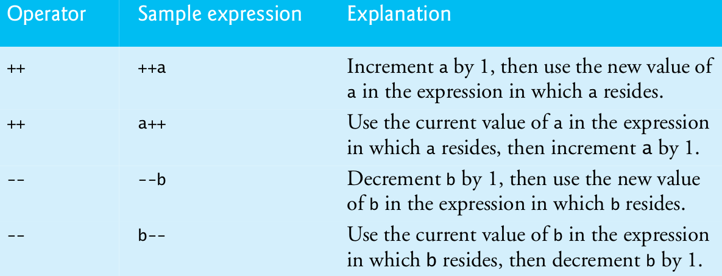
Unary Operators
Credits: How to Program C

Slide 30
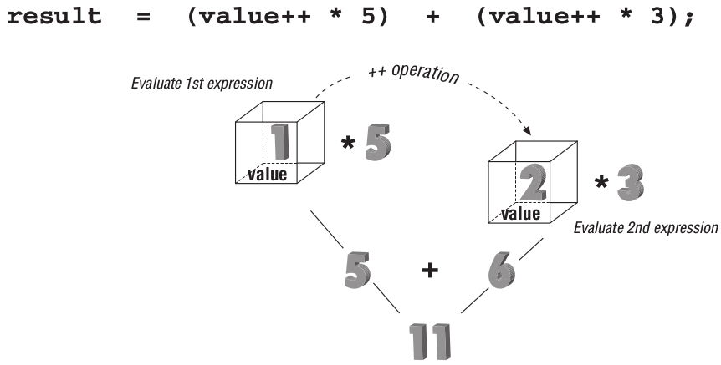
Side-Effect Problems
Credits: Practical C Programming

Slide 31
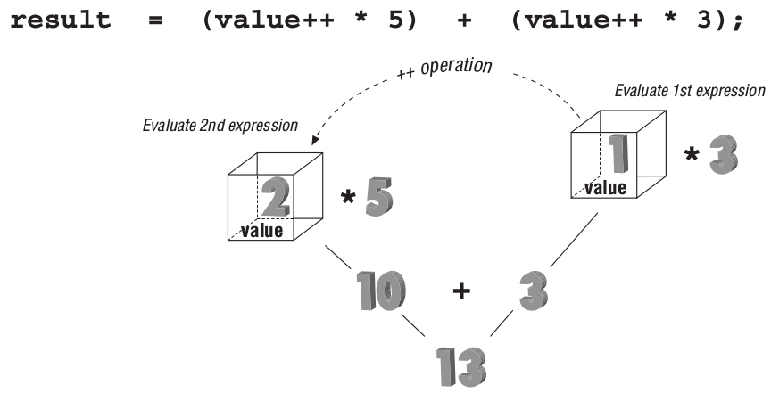
Side-Effect Problems
Credits: Practical C Programming

Slide 32
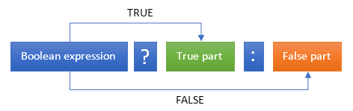
Conditional Operator
Credits: codeforwin.in &

Slide 33
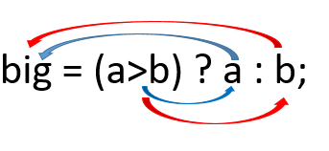
Conditional Operator
Credits: codeforwin.in & infoletcodes.blogspot.in

Slide 34
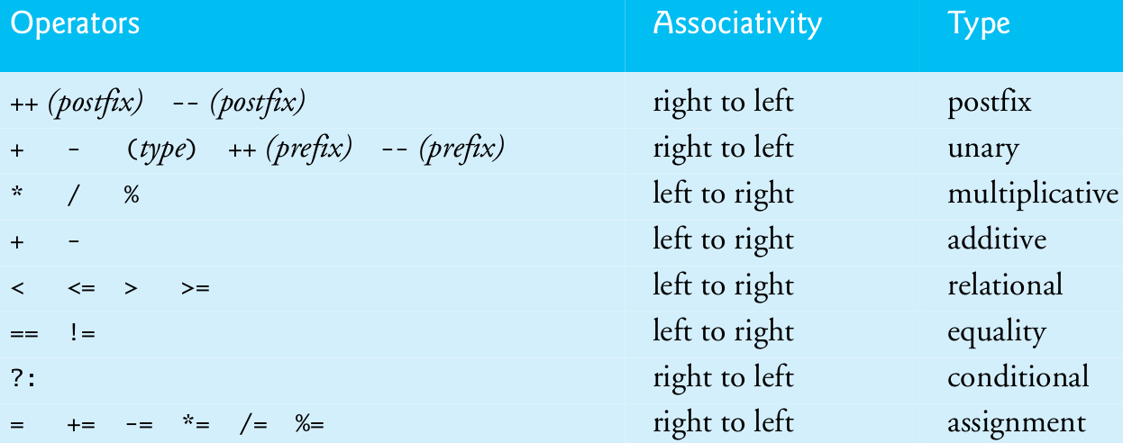
Big Picture

Slide 35
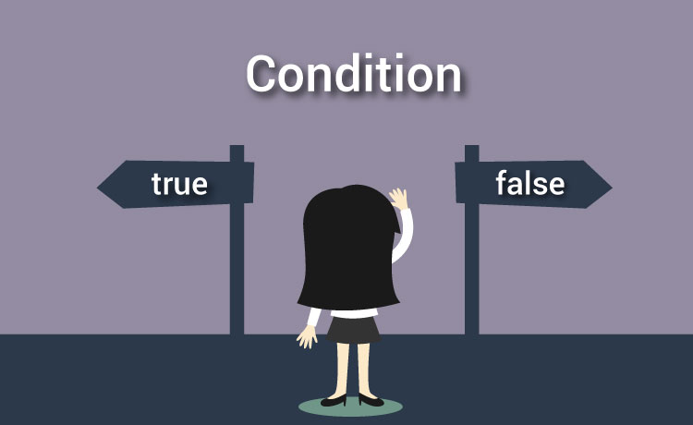
CSE102
Computer Programming
(Next Topic)
Credits: programiz.com

